Slide 1
AI Tools in Research
by
Dr. Rabia Javed
Computer Science Department
Lahore College for Women University, Lahore.
10/10/2025
Notes:
"Today, we'll start by understanding the common pain points in research, then we'll explore a suite of AI tools designed to solve them."
"We'll look at specific tools, how they fit into the research lifecycle, and finally, how to use them ethically and effectively."]

Slide 2
Today’s Agenda
7 Game-Changing AI Tools in 2025
The Research Lifecycle is Complex
Categorizing the Tools
  Idea Generation: Find and validate novel research topics.
  Literature Review: Streamline review and synthesis.
  Academic Writing and Editing: From drafting to structuring papers.
Ethical Practice: Use AI responsibly and effectively.
AI Tools for Research by: Dr. Rabia Javed
Notes:
Using Groundbreaking AI Tools That allow u to publish in top journals in the field
turbocharge ur Research
Streamline Paper Writing
How to use these tools at each stage of the research and writing process, from finding research topics that get you published in high-impact journals

Slide 3

The Research Lifecycle is Complex
❌ Literature Overload: Thousands of papers, too little time.
❌ Inefficient Reading: Struggling to understand complex methodologies.
❌ Writing Barriers: Polishing language for journal submission.
❌ Finding Gaps: Identifying a truly novel research question.
AI Tools for Research by: Dr. Rabia Javed

Slide 4
Categorizing the Tools
💡 Idea Generation: Generating and refining ideas.
🔍 Literature Review: Discovery, Search and Finding the right papers.
📖 Reading & Comprehension: Understanding papers faster.
✍️ Academic Writing & Editing: Crafting a polished manuscript.
AI Tools for Research by: Dr. Rabia Javed

Slide 5
“AI is great especially for simple and/or repetitive, boring tasks. But whatever concerns the *content* and thinking of your work, you might be better off doing it yourself. With the right technique, you might be even faster doing it yourself.”
AI Tools for Research by: Dr. Rabia Javed

Slide 6
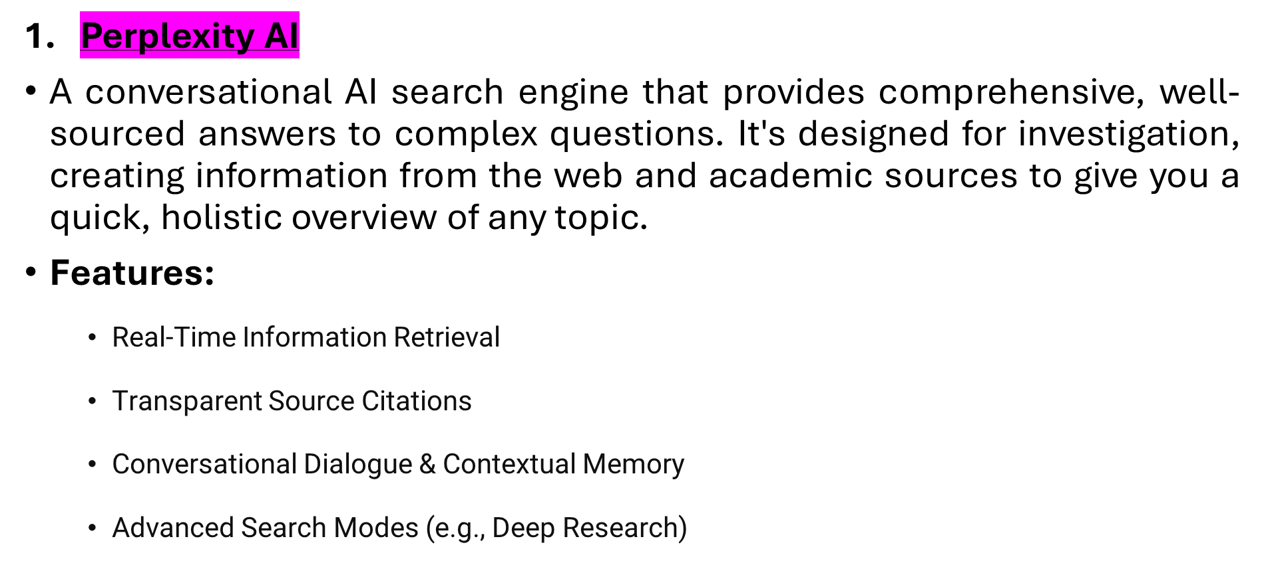
Idea Generation
AI Tools for Research by: Dr. Rabia Javed
Notes:
Building a strong research proposal just got easier with these free AI tools! As someone who uses BeLikeNative for academic writing, I'm impressed by how these tools streamline the research process while maintaining quality. The formatting tips were especially helpful!

Slide 7
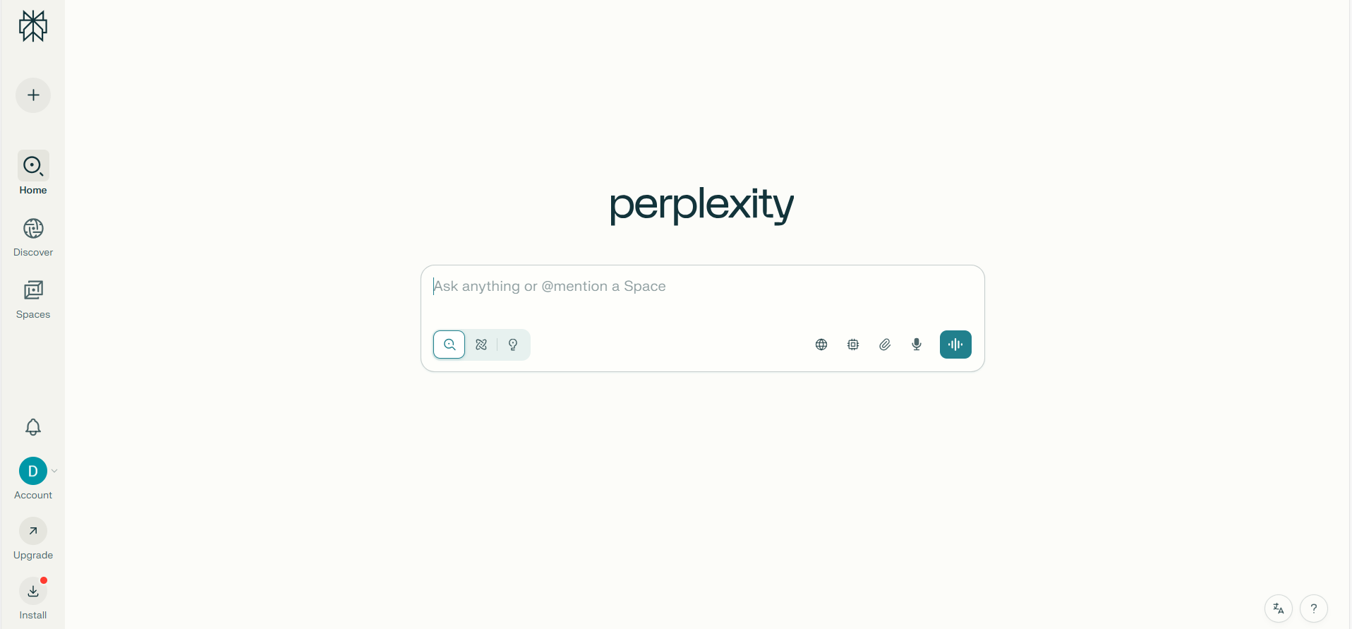
→ Link: https://www.perplexity.ai/
AI Tools for Research by: Dr. Rabia Javed

Slide 8
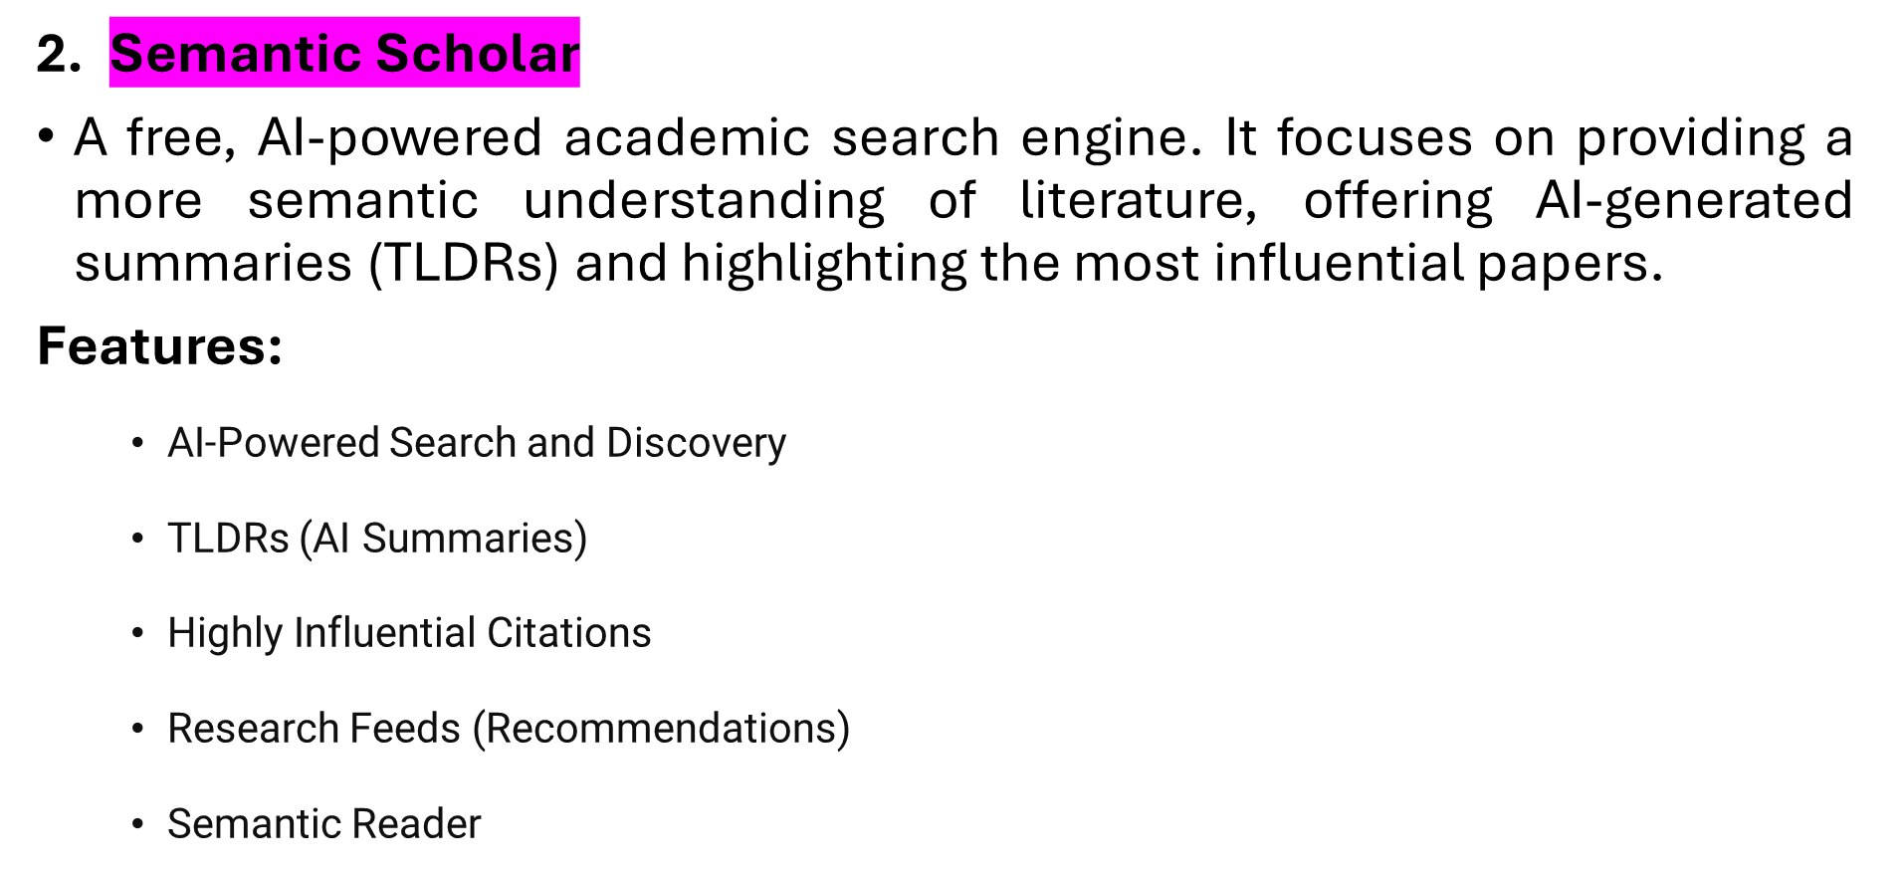
Idea Generation
AI Tools for Research by: Dr. Rabia Javed
Notes:
Building a strong research proposal just got easier with these free AI tools! As someone who uses BeLikeNative for academic writing, I'm impressed by how these tools streamline the research process while maintaining quality. The formatting tips were especially helpful!

Slide 9
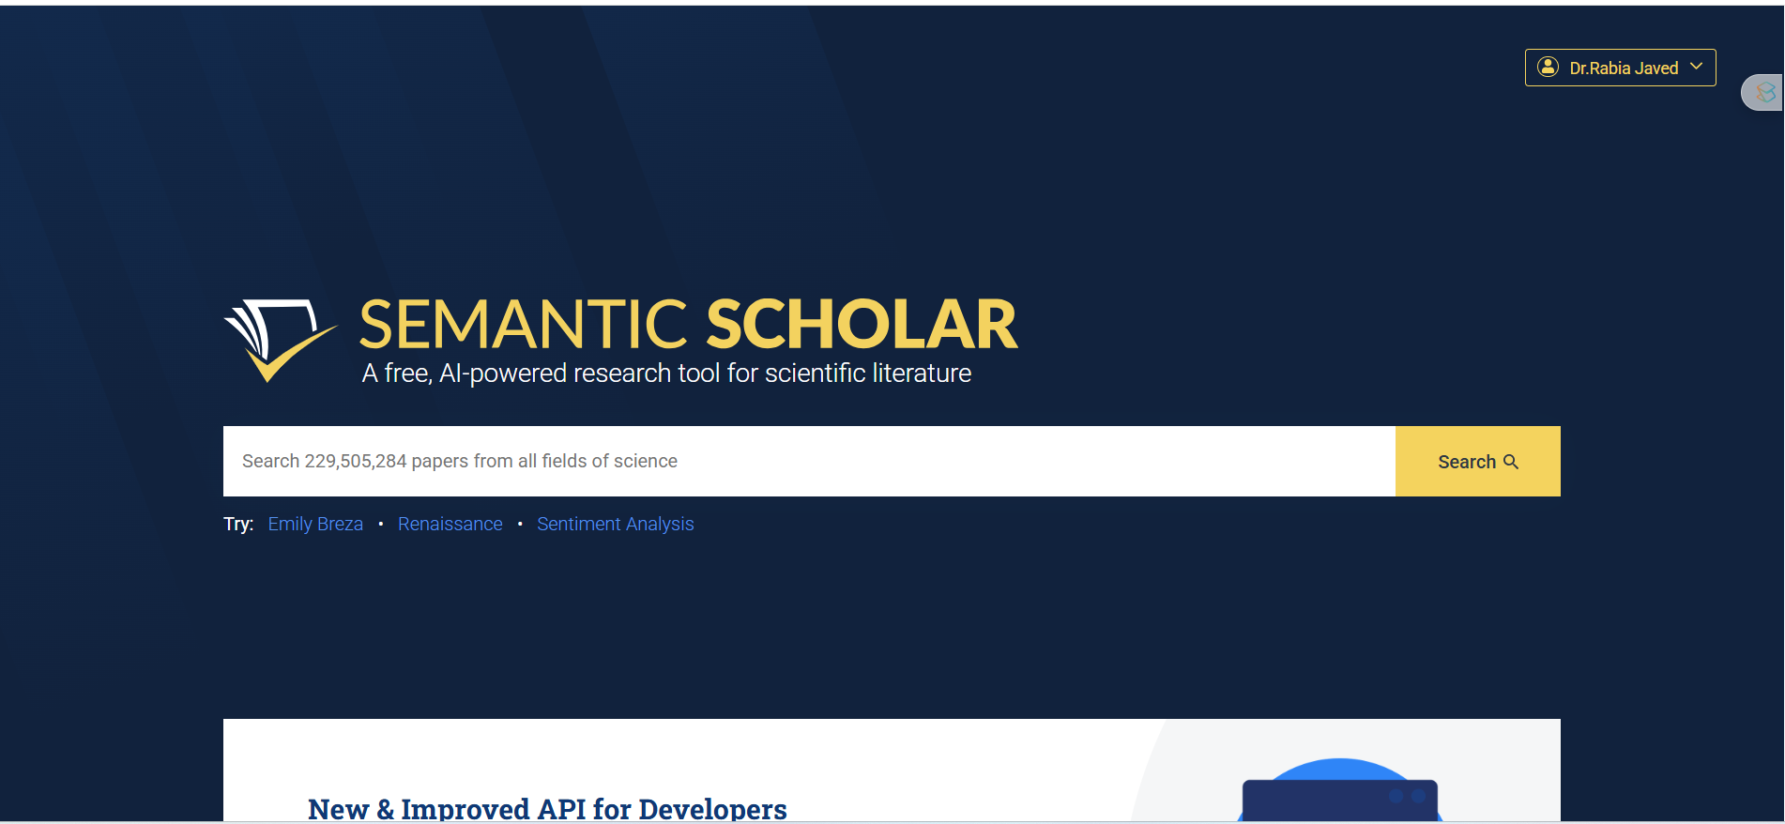
→ Link: https://www.semanticscholar.org/
AI Tools for Research by: Dr. Rabia Javed

Slide 10
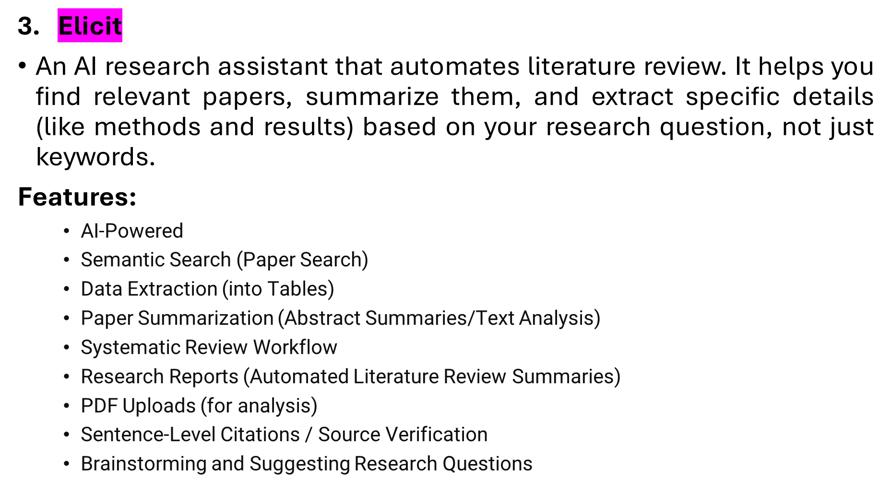
Literature Review
AI Tools for Research by: Dr. Rabia Javed

Slide 11
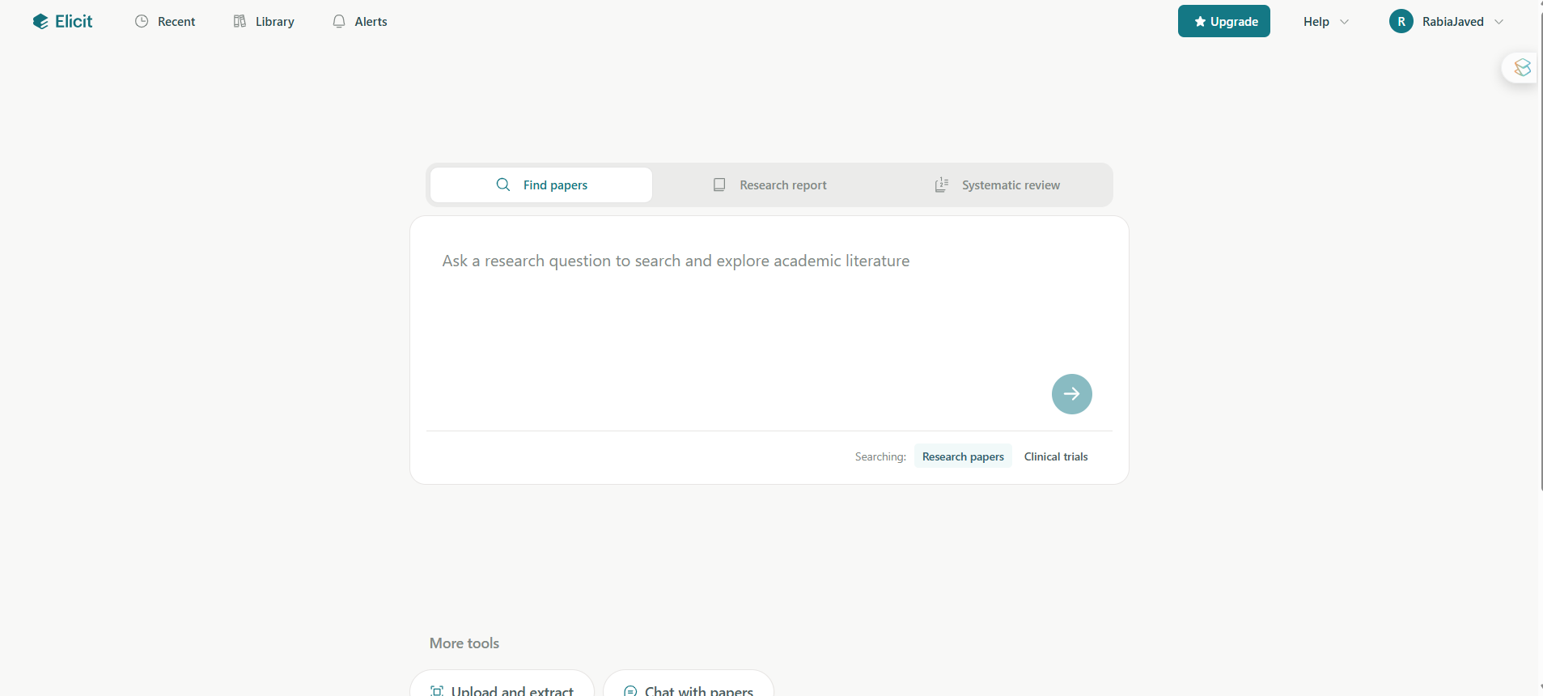
→ Link: https://elicit.com/
AI Tools for Research by: Dr. Rabia Javed

Slide 12
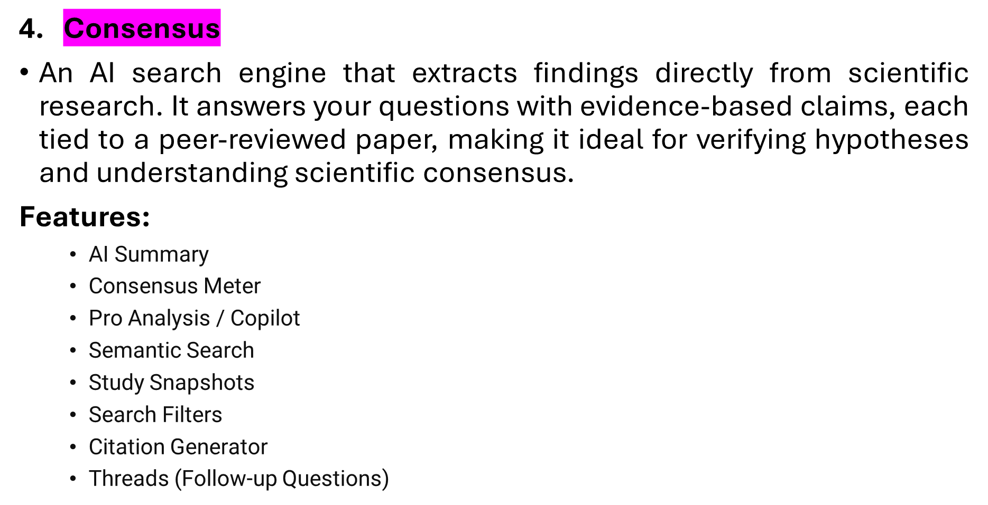
Literature Review
AI Tools for Research by: Dr. Rabia Javed

Slide 13
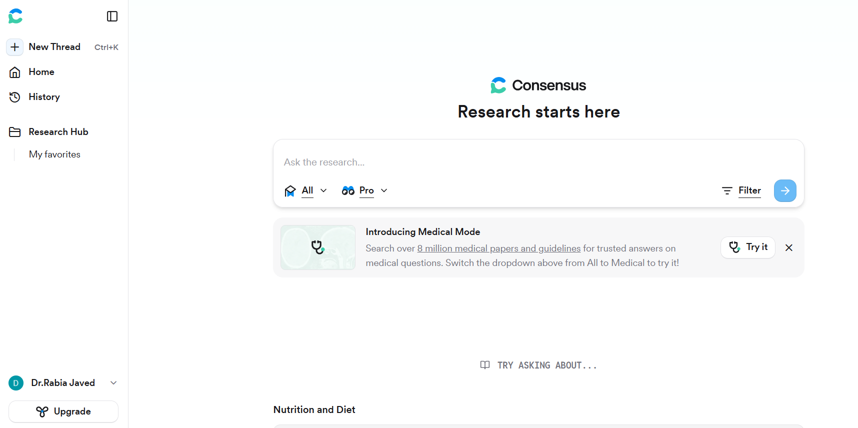
→ Link: https://consensus.app/
AI Tools for Research by: Dr. Rabia Javed

Slide 14
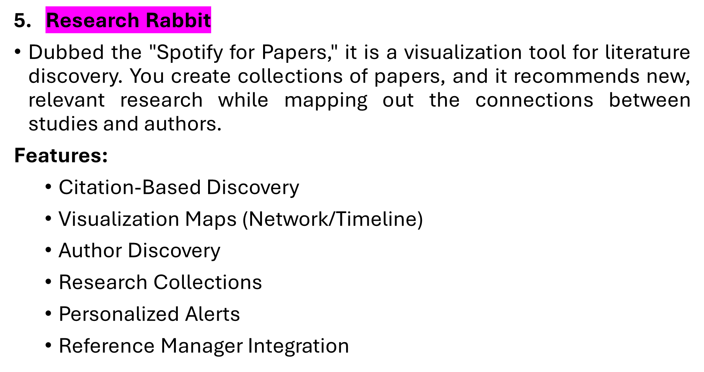
Literature Review
AI Tools for Research by: Dr. Rabia Javed

Slide 15
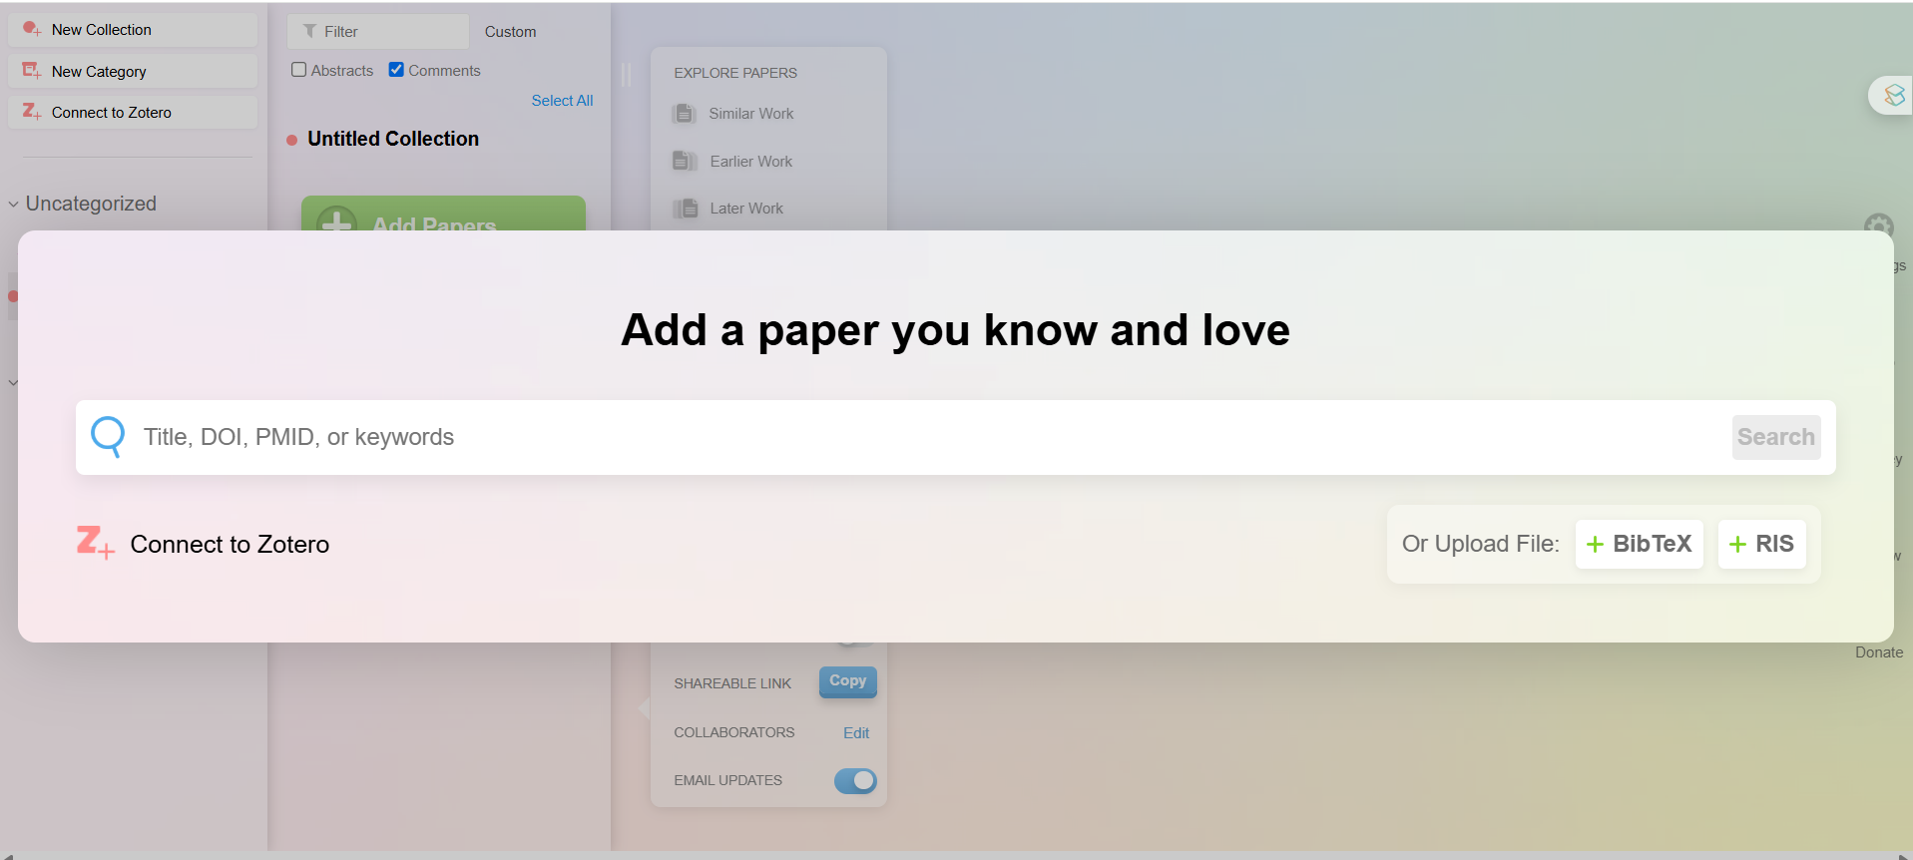
→ Link: https://researchrabbitapp.com/home
AI Tools for Research by: Dr. Rabia Javed

Slide 16
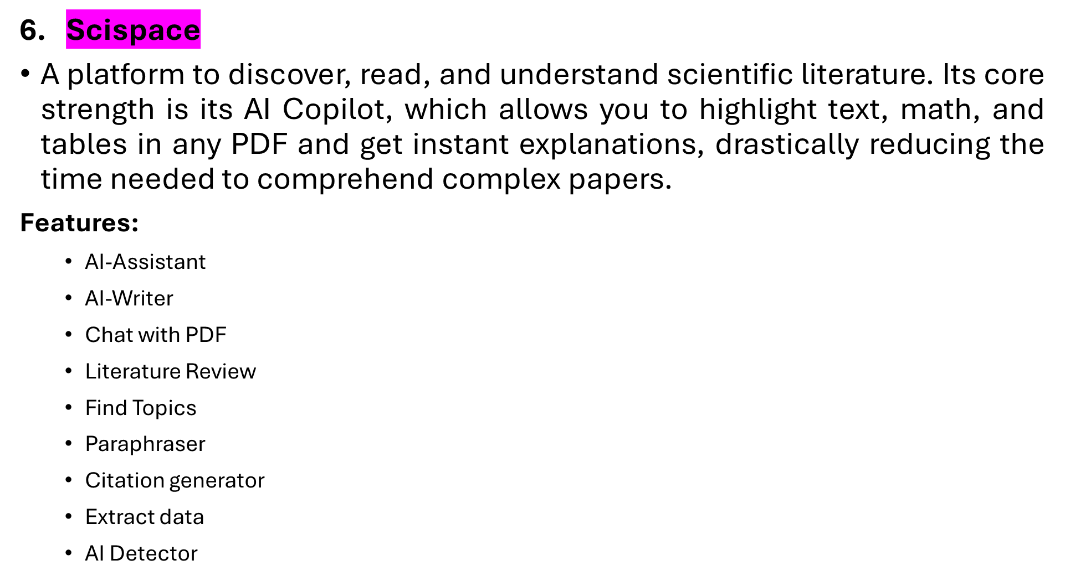
Literature Review
AI Tools for Research by: Dr. Rabia Javed

Slide 17
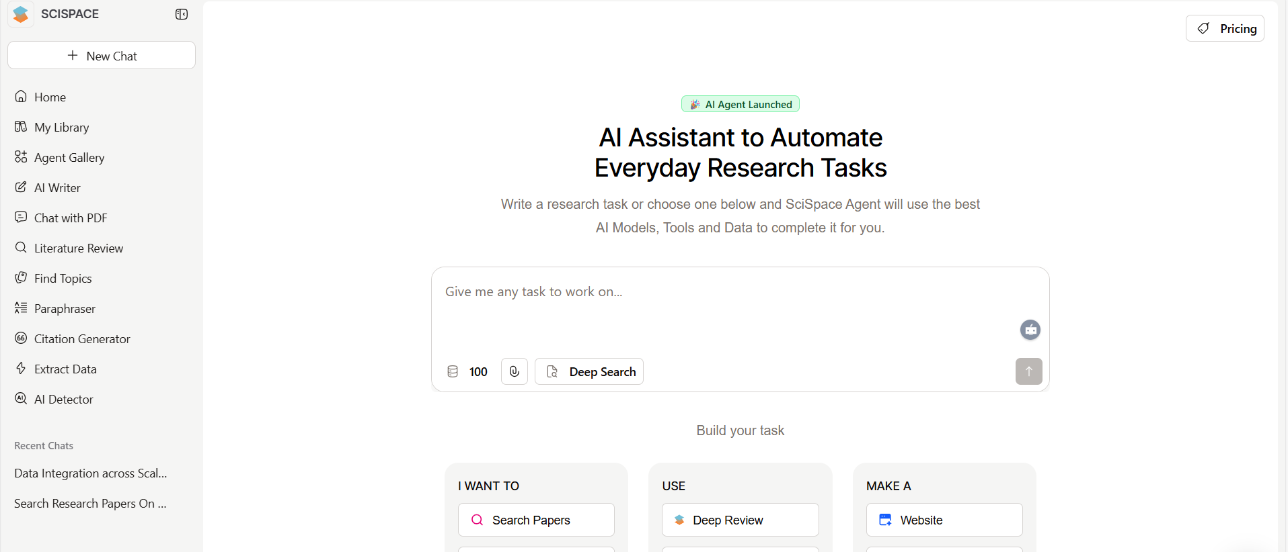
Link: https://scispace.com/
AI Tools for Research by: Dr. Rabia Javed

Slide 18
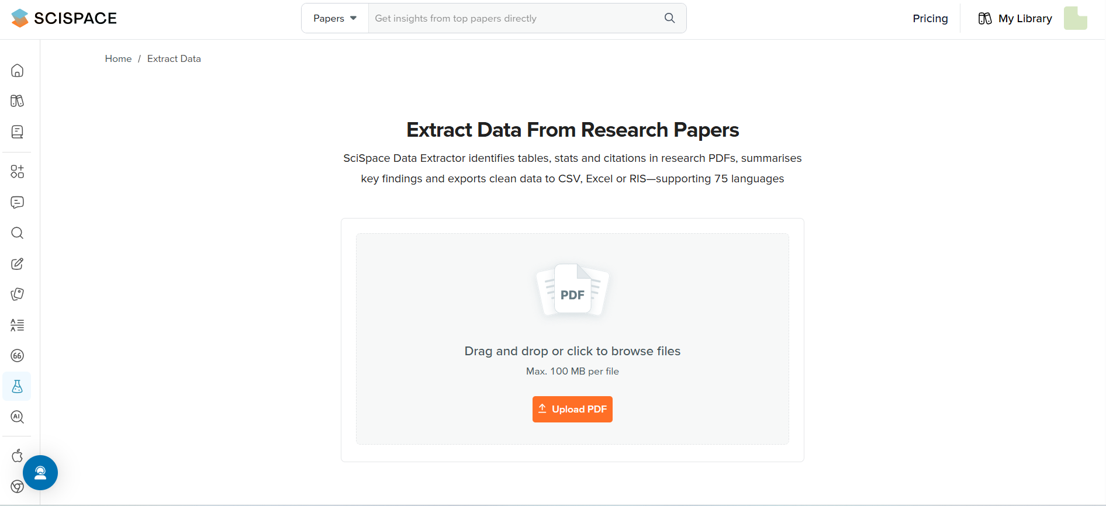
2. Link: https://scispace.com/extract-data
AI Tools for Research by: Dr. Rabia Javed

Slide 19
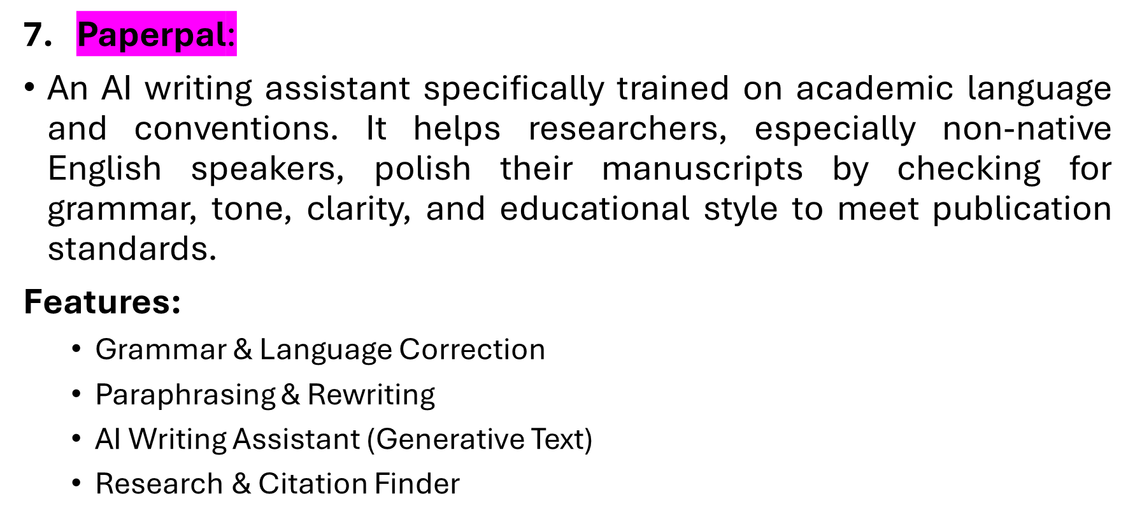
Academic Writing and Editing
AI Tools for Research by: Dr. Rabia Javed

Slide 20
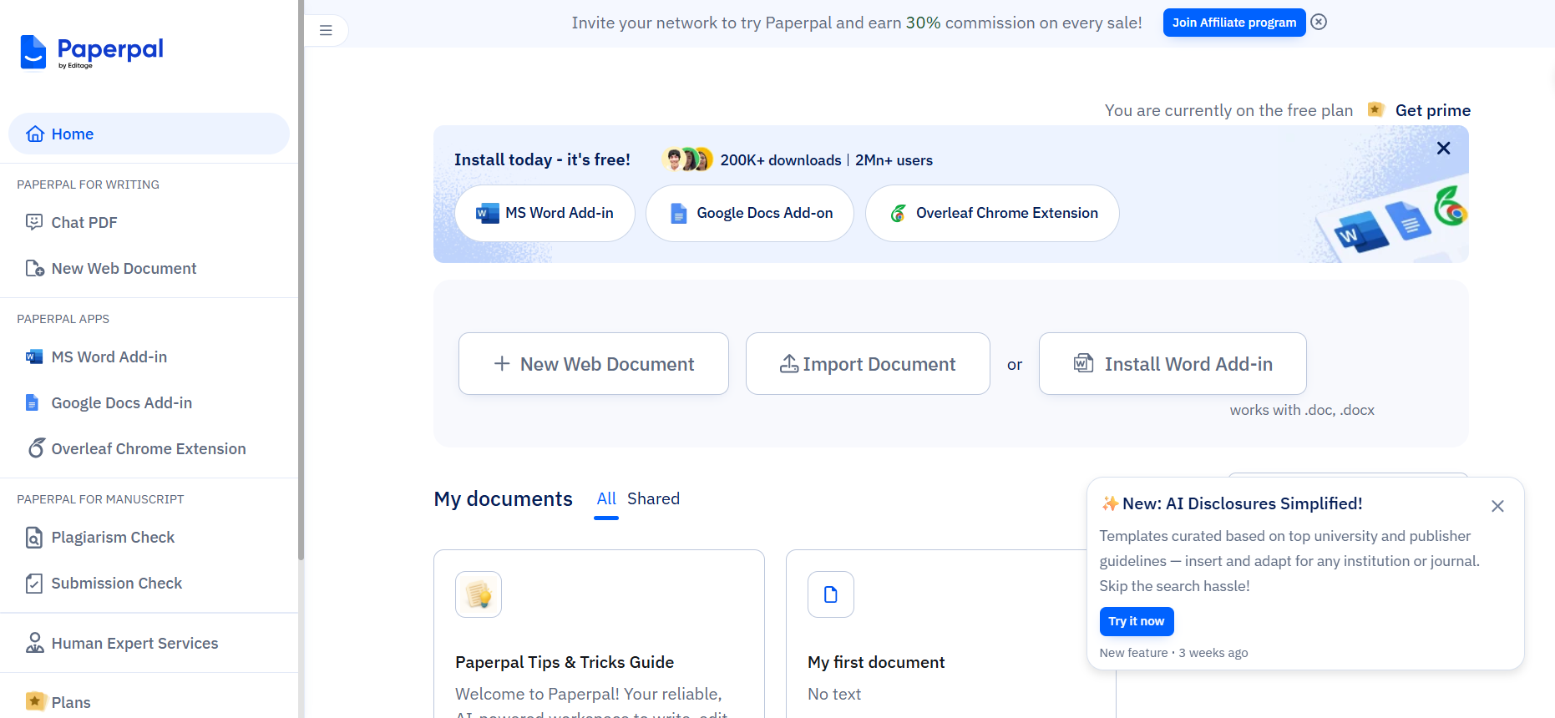
→ Link: https://edit.paperpal.com/
AI Tools for Research by: Dr. Rabia Javed

Slide 21
AI Research Tools – Features Comparison
AI Tools for Research by: Dr. Rabia Javed

Slide 22
AI Tools | Research Phases | Free | Strengths | Limitations
Perplexity | Ideate | Basic | Search Engine, Web + academic sources | • Hallucinates • Relies heavily on general web search quality
Semantic Scholar | Ideate | Full | Search Engine, Semantic Approach, Summary, Highlight influential papers | • Limited to academic papers/sources only • Focuses on influential, not necessarily the latest, papers
Elicit | Literature Review | Limited | Relevant papers, Summaries, Exact specific details | • Limited to specific types of papers (e.g., those with abstracts) • May not capture the full context of a study
Consensus | Literature Review | Limited | Scientific & Evidence based | • Limited database size
Research Rabbit | Literature Review | Full | Visualization & Mapping tool | • Requires an initial seed paper to start
SciSpace | Ideate/ Literature Review | Limited | AI Copilot, ChatPDF, Explaining Complex Papers | • Paywall limits advanced/frequent use of AI features
PaperPal | Writing & Editing | Limited | Real-time academic grammar check, Paraphrasing, Tone | • Free version is highly restrictive
AI Tools for Research by: Dr. Rabia Javed
Notes:
"The real power is in the combination. Here’s a potential workflow: Start broad with Perplexity, then use Elicit to find papers, analyze them with Scispace, and finally write and edit with Paperpal."
"This creates a seamless, efficient pipeline from idea to publication."]

Slide 23
Things to keep in mind when using Text Generation AI safely
Use AI Responsibly and Effectively
🔒 Privacy: Never upload sensitive, unpublished, or proprietary data.
❌ Fact-Check: AI can hallucinate (make up) facts and citations. Always verify against original sources.
🤔 You are the Expert: AI is an assistant, not a replacement for critical thinking and deep understanding.
📜 Check Policies: Some journals require disclosure of AI use. Always check their guidelines.
AI Tools for Research by: Dr. Rabia Javed

Slide 24

Wrap-up and Feedback Collection
Summary of the day and collection of participant feedback.
AI Tools for Research by: Dr. Rabia Javed

